Slide 1
Developing Secure Applications
By writing properly secured code

Slide 2

What is secure code?
Secure code is written to prevent users, and malicious third parties, from gaining access to software states and information they should not normally have access to.

Slide 3
What Happens when code isn’t secure?
Office of Personnel Management data breach
21.5 million records of people employed by the government (including contractors and individuals with security clearances) were stolen and then exfiltrated.
This included clearance information, personal details, and fingerprints of the affected individuals.
Equifax Breach
Identity related information of 145.5 million US consumers was stolen by identity thieves.
Data stolen included full names, Social Security numbers, birth dates, addresses, and, in some cases, driver license numbers.
This is the information used by banks, employers, and hospitals to verify identity.

Slide 4
Common Programming Malpractice
Buffer Overflows
Stack Overflows
Null errors

Slide 5
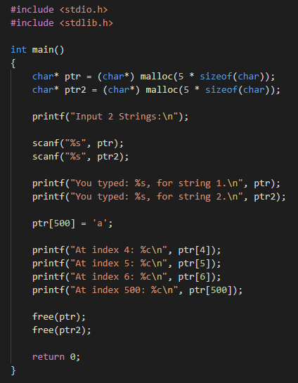
Buffer Overflow
A buffer overflow is when memory outside a buffer is accessed.
This commonly happens when dynamic memory management is involved. (See the code on the left)
Here we allocate 2 char arrays of size 5, but we are accessing sections of the array that are not actually part of the array.
This code can compile and run, it is possible it could end in a segmentation fault (Segfault) and crash. But it is possible that data could be illegitimately read or altered.

Slide 6
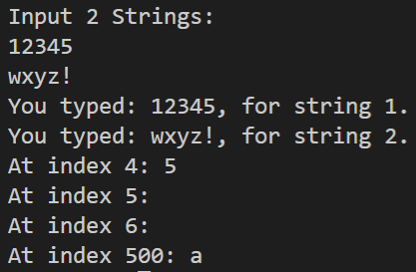
Buffer overflow output
Shown on the right is the output from the code on the previous slide.
Here no text data was found at the indices just outside the bounds of the array.
We were able to however adjust the value of the byte referenced by ptr[500]

Slide 7
Buffer overflow Result
Due to the fact that arbitrary bits of memory can be read and altered buffer overflow errors can result in arbitrary code execution.
A recent buffer overflow error discovered in some Fax enabled multifunction printers allows an attacker to send a carefully crafted document to an open fax line and gain a foothold in target networks through the network enabled printer devices.

Slide 8
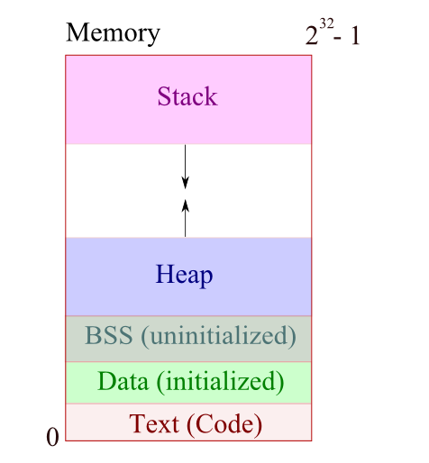
Stack Overflows
Stack overflows are a type of out of memory (oom) error.
It typically occurs as the result of too many function/method invocations being “on the stack”.
A call stack is a stack data structure that stores information about the active subroutines of a computer program.

Slide 9
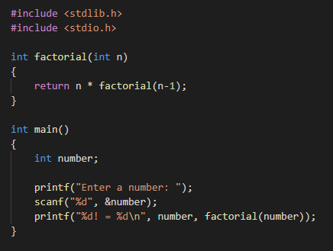
Causing a Stack Overflow
An intentional stack overflow can easily be created using a recursive method in which you have forgotten the base case.
Take calculating factorials for example.
The code on the right would result in a stack overflow because the recursive factorial function would continue infinitely into negative numbers.
Because each instance of the function cannot resolve until all following instances have resolved, they will continue to accumulate on the finite stack.

Slide 10
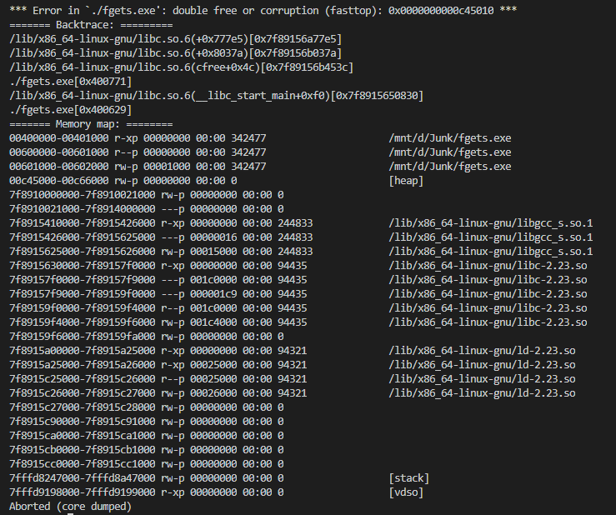
Null Errors
Null errors are caused by referencing pointers (in functional languages) or objects (in OO languages) that have not been properly instantiated, or have since been freed/garbage collected.
In their simplest form they can immediately terminate execution of the program.
Carefully crafted null errors can lead to information disclosure, whether through crash/debug information that is generated, or in a worst case through bypassing security logic.

Slide 11
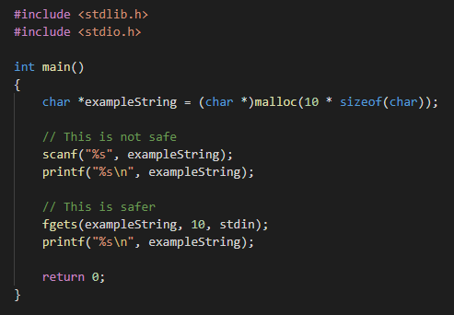
Secure programming practices
Using secure functions
While many are accustomed to using the basic functions like scanf(), more secure options exist.
fgets() is one of those options. It allows you to specify exactly how many characters to read from the target buffer.
This prevents a buffer overflow error by only allowing content that will fit in the buffer to be read.

Slide 12
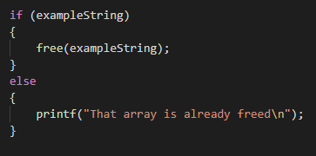
Secure programming practices
Checking null status before operations
In C it is a good idea to set pointer variables to null after freeing them to prevent a double free.
This also allows you to perform a check like the one on the right.

Slide 13
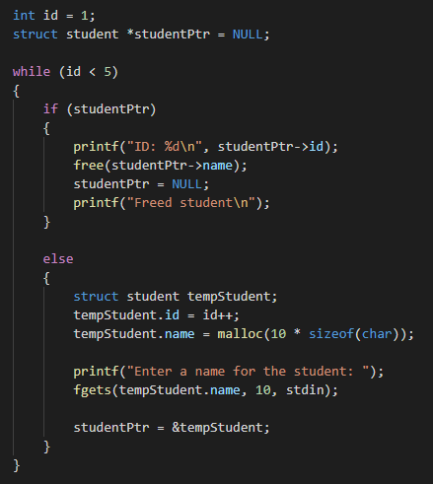
Secure programming practices
You can use the same kind of logic in more complex situations.

Slide 14
Common Application security Blunders
Poor Authentication management
Client side validation
Accepting freeform user input without safeguards
Database (MS SQL, MySQL, MongoDB) configuration
File permissions
URL parameters
Unencrypted web traffic
Improperly configured API’s

Slide 15
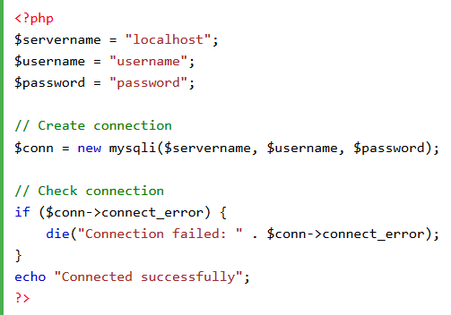
Authentication Management
Passwords stored in plain text
While it is easiest to just store passwords directly in source code or configuration files, this is also one of the top ways credentials can be found by third parties

Slide 16
Proper Authentication Management
There are many ways authentication can be managed more securely.
Token based authentication can allow specific access to aspects of a resource without exposing login credentials.
Login information (token or otherwise) can be encrypted and stored in a configuration file instead of being stored in plain text.
Authentication used by applications should only have access to the minimum necessary resources to do their jobs.

Slide 17
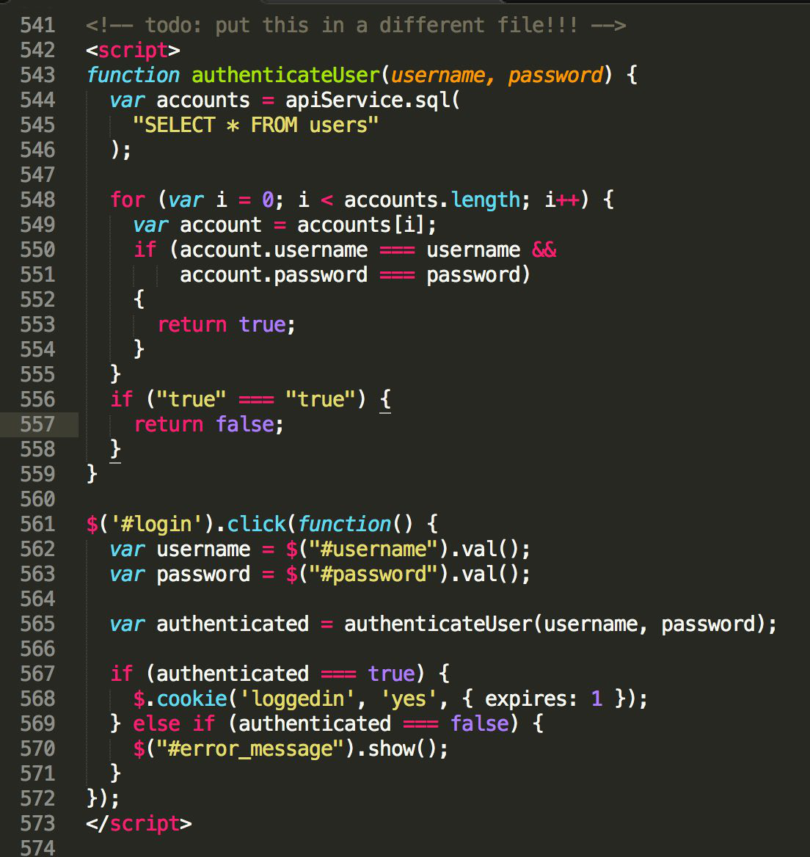
Client Side Validation
F12 (Developer Console) is your enemy
HTML, CSS, and JavaScript written for websites is all 100% accessible to any user who visits your website
If you put any sensitive information in a JS file (like login credentials and connection strings) they can be used to craft custom queries
Data returned (i.e. login credentials and user information) can be inspected when returned from a DB query

Slide 18
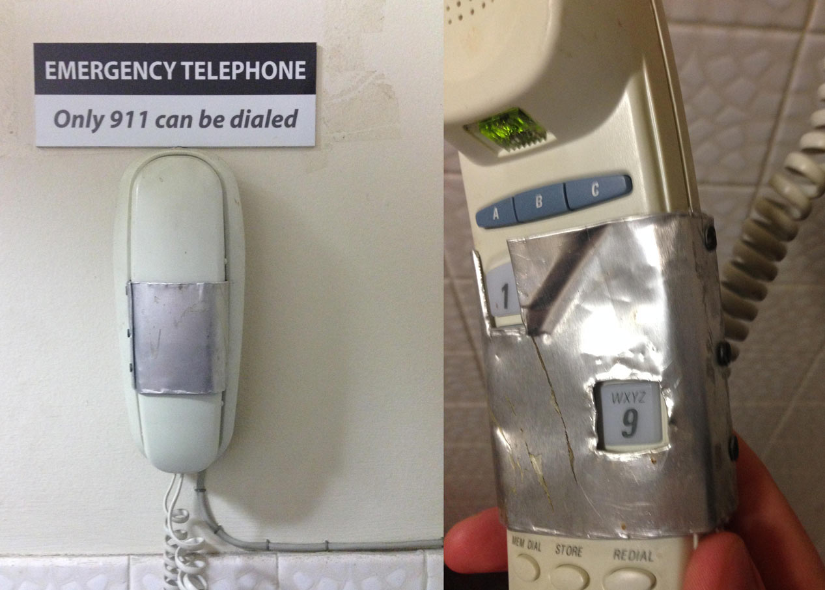
Proper Validation
It’s easy to do a select on a User table to check if the username exists and the given passwords match.
But then the user can often inspect what happens when a login has succeeded and replicate that process without a valid login.
Some input validation can be handled on the client side of an application, but the majority should be handled server side.
This prevents users from deconstructing the application and gaining access to information they shouldn’t have.

Slide 19
Freeform user input
Freeform user input can be scary enough in C and Java programs because it can cause the program to crash. This issue is greatly magnified when it comes to web technologies.
Input not being properly sanitized can lead to:
SQL Injection
Cross Site Scripting
SQL errors
Process crashes

Slide 20
SQL Injection
SQL injection is when a user intentionally crafts an input string they know will be used in an SQL query.
For example, if a login attempt is handled by checking a User table for an entry that has a specific Username/Password combination, it might use something like the following:
SELECT * FROM user_table WHERE user_name = bob AND password = hunter2
This SQL command is probably crafted by using something like the following:
“SELECT * FROM user_table WHERE user_name = “ + userName + “ AND password = “ + password
If the user were to put bob -- as the username you would wind up with
SELECT * FROM user_table WHERE user_name = bob -- AND password =
That double hyphen is the comment syntax for SQL and results in delivery of all user accounts with the username bob regardless of password

Slide 21
Cross-Site Scripting
There are many cases when a website would display user input: messages that display the user’s name, comment sections, messaging/email clients to name a few.
If user input is handled as a string literal and passed into an html interpreter this can lead to issues.
They can be minor annoyances like linking to loud obnoxious media or they can be major issues like keyloggers.
This happens because of the nature of nested tags in html. If you have a <div> element that is supposed to only have text in it, but if you add a <script> element inside, it will be interpreted as executable JavaScript code instead of plain text.

Slide 22
Sanitizing Data
Many languages have built in ways to deal with free form user input.
For dealing with SQL statements php and C# both offer parametrized statements.
PHP: $stmt->bind_param('s', $name);
C#: query.Parameters.AddWithValue("@variable", value));
These will cause any special characters to be properly escaped so they will be interpreted as plain text instead of as commands/scripts.
In just about any other case, removing or escaping things like quotes, commas, and </> with replace functions will do a good job of preventing these issues.

Slide 23

SQL Configuration
By default database management engines have an admin account (sa for MS SQL and root in MySQL)
If these accounts are not properly configured at setup they can be a major liability
Someone who obtains the credentials for an admin account can modify, delete, or download any information they please contained in the DB
Pairing the default admin account with poor authentication management can lead to disastrous data leakages and corruption

Slide 24
Proper SQL Configuration
Change the default passwords!!!
In order to prevent users from gaining more access than is necessary multiple user accounts can be created for a SQL database
These user accounts can be configured in a number of useful ways
Read-Only: If a website needs to deliver content but not upload it, then it can be set up using a read only account. If the credentials are compromised, malicious third parties will not be able to edit any of the entries.
Table Specific Access: Users can be created that have no access to any DB information. These unprivileged users can then be granted things like insert only or select only access to one specific table.
Disabling sa: The default server administrator account can be disabled when it is not needed. An admin would then have to have access to the machine to reenable the sa account.

Slide 25
File Permissions
Web files are stored in your web directory
C:/inetpub/wwwroot on Windows
/var/www/html on Linux
Files anywhere under the tree are accessible to those who can guess the URL for the file.
For example, if and admin page isn’t properly password protected, and a user guesses that the page is at yourwebsite.com/admin.php they can gain access.
Storing user uploaded files in a sub directory of the root web folder can lead to leakage of information, if a user can guess the path to and name of the file.

Slide 26
Proper File Permissions
To protect these files it is necessary to create a separate folder elsewhere on the system and create a script or program that can manage authentication and file delivery.
On *nix systems it is also a very good idea to automatically disable the executable bit ( $chmod –x filename ) of all files to prevent malicious scripts/code from being run on your server.

Slide 27
URL Parameters
URL Parameters are a super simple way to pass information to a website.
They follow the domain, separated by a ?
The parameters are separated by an &
They are completely insecure. Anyone who can see your web traffic (Network Admins, ISPs, Man-In-The-Middle Attackers) can see the parameters.
Any variables you try to pass that contain sensitive information will be readily available for anyone who inspects the traffic.

Slide 28
Get and post
There are 2 ways to send data to a server from a client machine viewing a website.
GET
Uses URL Parameters
Is limited in how much data can be sent (Depends on the browser, usually caps out around 1-2KB)
Data is Encrypted when using HTTPS/TLS, but can be leaked through things like web server logs
Data is always available to things like Browser Plugins
POST
Included in the HTTP request
Not visible in the URL
No limit to amount of transfer
Data is transferred securely when encrypted using TLS

Slide 29
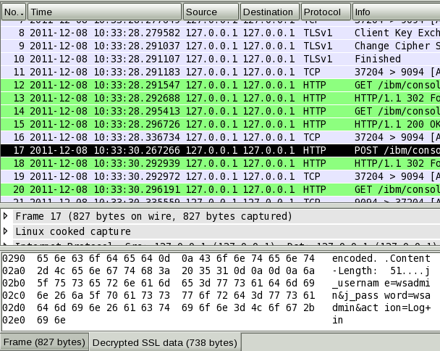
Unencrypted Web Data
Web traffic sent over HTTP is sent in plain text that anyone with network access can read
Even if you don’t make it super easy by using URL parameters, programs like Wireshark allow users to open and view the contents of packets
Both GET and POST requests are visible
Sometimes the headers are what attackers are interested in. Other times they are interested in the actual content.

Slide 30
Encrypting web traffic
What are TLS and HTTPS?
TLS
Stands for Transport Layer Security
Is a cryptographic protocol that provides communications security over a computer network
Allows encrypted network communication between devices
HTTPS
Stands for HyperText Transfer Protocol within SSL (The old version of TLS)
Relies on Certificate Authorities (CAs) to verify the identity of websites

Slide 31
Encrypting web traffic
How to set up TLS and HTTPS?
Many hosting providers offer services that will set up and configure TLS along with dynamic DNS for you.
If you are self hosting a website, Let’s Encrypt (letsencrypt.org) offers free automated certificate management.

Slide 32
Improperly Configured API’s
What is TLS?
Let’s Encrypt
Manually

Slide 33
Creating Secure API’s
What is TLS?
Let’s Encrypt
Manually

